Slide 1


Performance vs Target
Last data refresh:
24/09/2024 15:46:09 UTC
Downloaded at:
24/09/2024 16:08:52 UTC

Slide 2
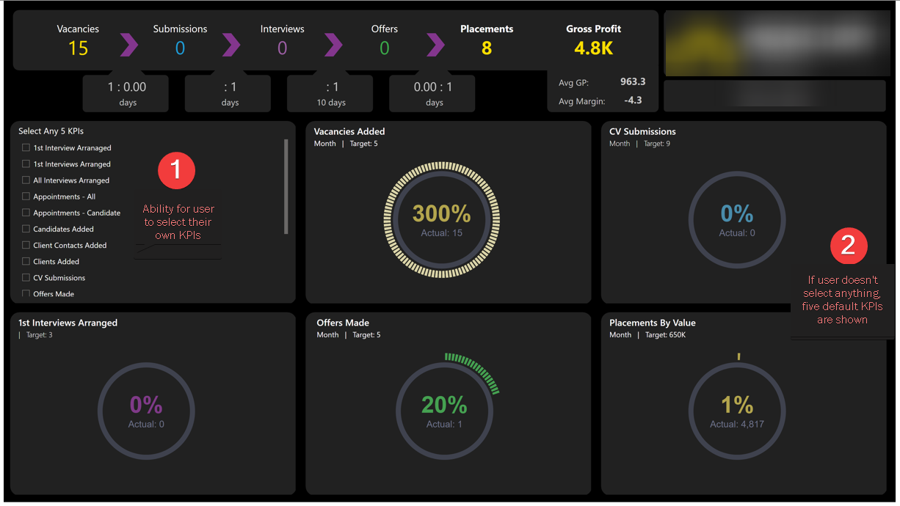

Slide 3
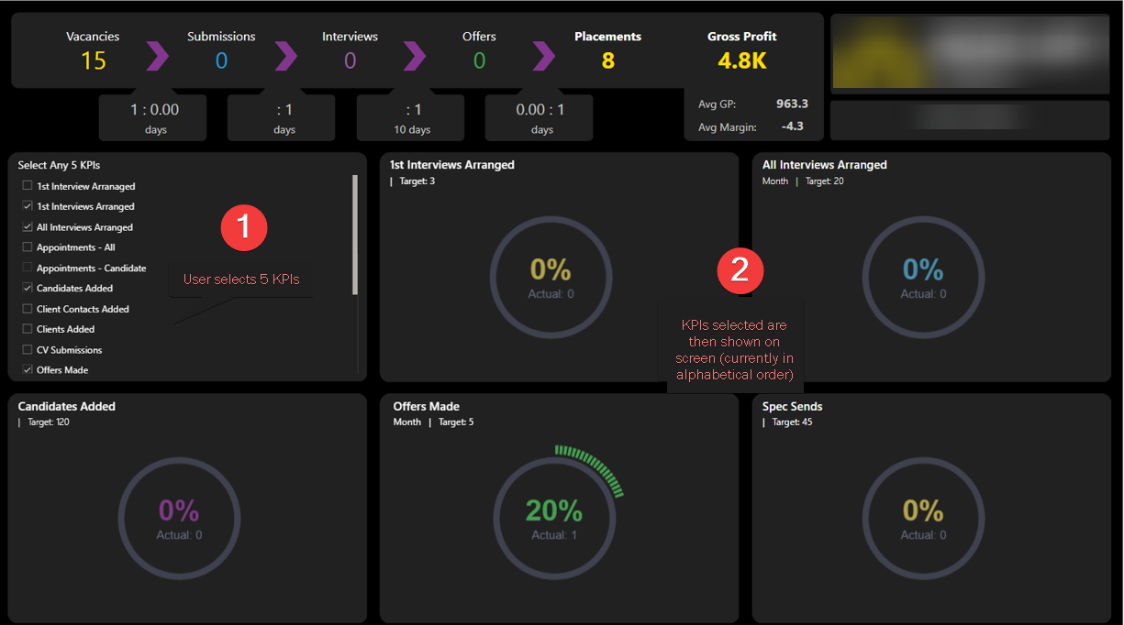

Slide 4
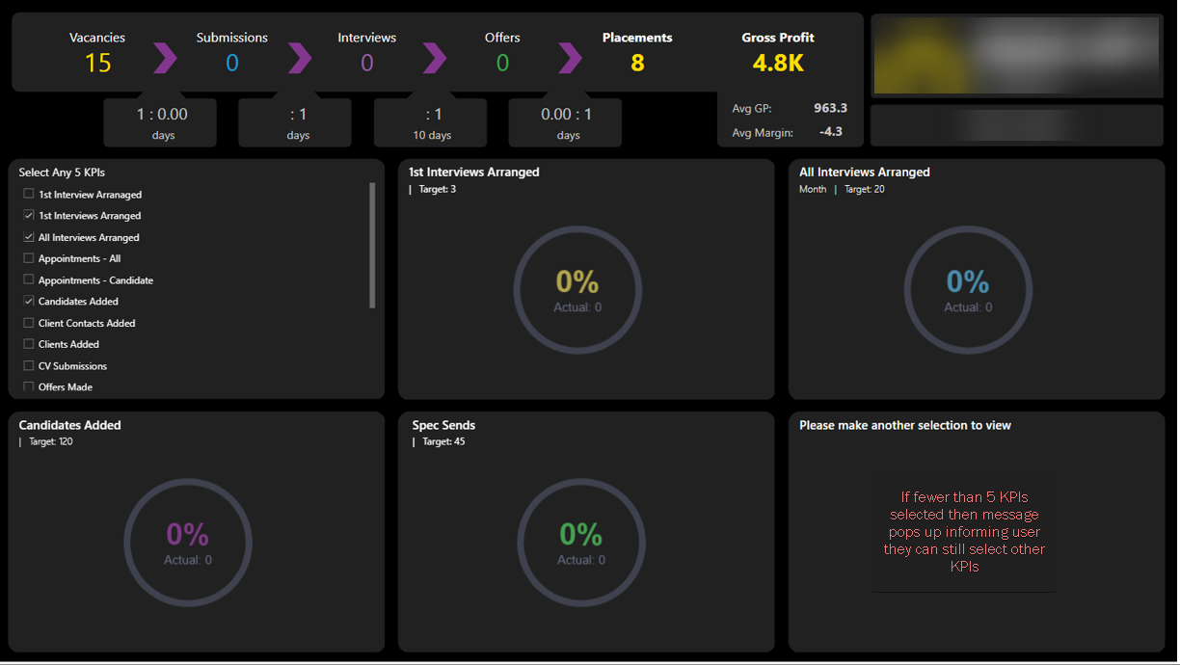

Slide 5
